Slide 1

Villain Island Villas
Taylor | Maria | Alex | George | Stewart

Slide 2
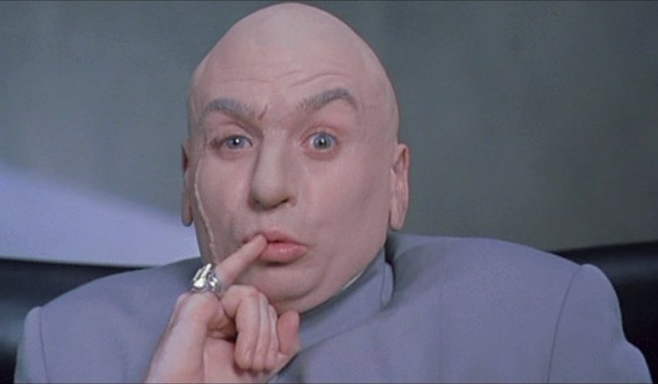
Dr. Evil

Slide 3
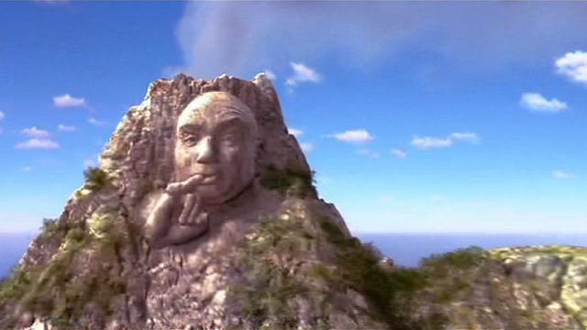

Slide 4
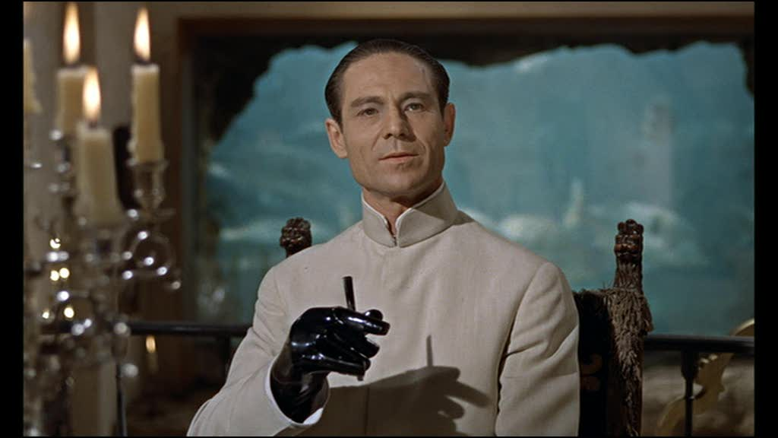
Dr. No

Slide 5
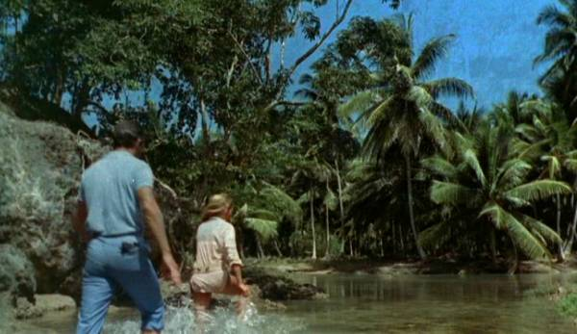

Slide 6
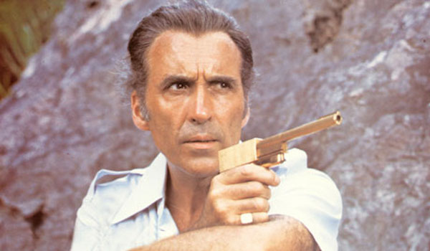
Francisco Scaramanga

Slide 7
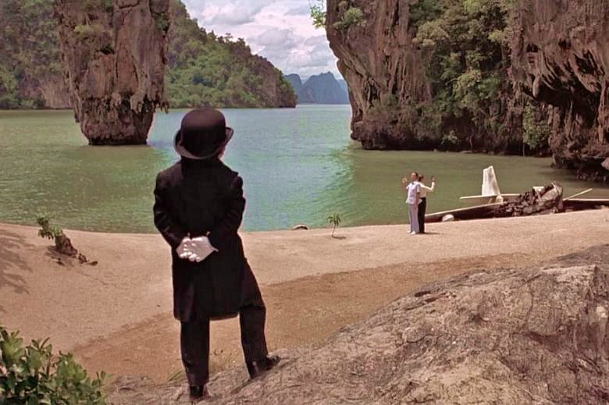

Slide 8
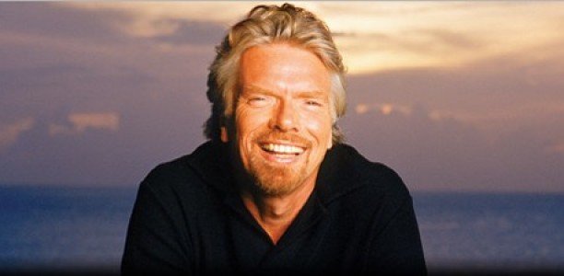
Richard Branson

Slide 9
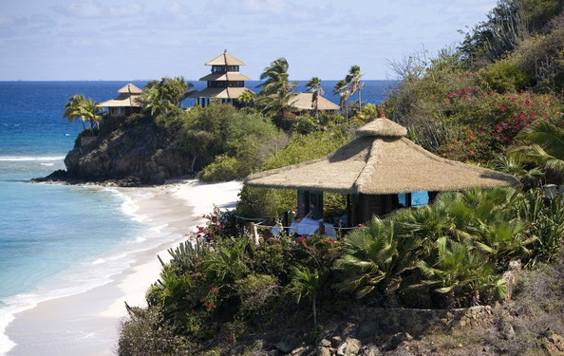

Slide 10

Our Process
Location
Acreage
Violence
Corruption
Unique Features

Slide 11

Our Super Top-Secret Resources Which we will reveal to you now in full detail before you escape our excessively-elaborate death trap!
Private Islands Online | UN Global Study on Homicide
Transparency International Corruption Perceptions Index | Geo-DB API
Python | Pandas | Plotly | HTML | Bootstrap | CSS
JavaScript | jQuery | D3 | Parsley | Flask | MongoDB

Slide 12

Be our guest…
http://islandlair.herokuapp.com/

